Slide 1
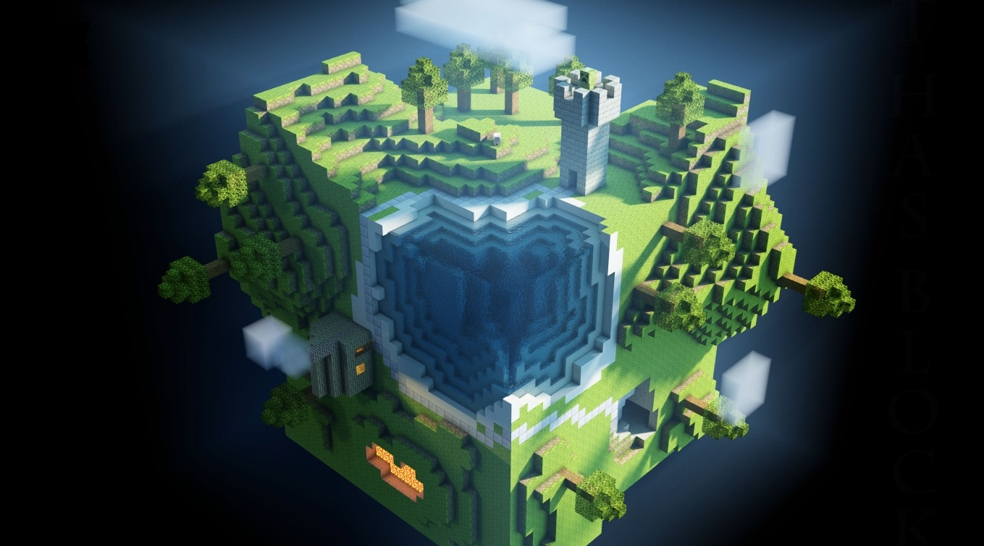
Nether
Gaming Building Blocks for Azure
An Open Sourced project composed of reusable set of building blocks, projects, services and best practices designed for Gaming workloads on Azure

Slide 2
Why?
We work with several gaming partners, from indie developers to AAA studios, all trying to solve the same problems over and over again.
We have learned that there are hardly new games coming out without a backend for player management, leaderboards and analytics purposes.
A set of resuable components, that leverage the power of the Microsoft Azure cloud will be beneficial for many game developers across the globe.

Slide 3
What?
An Open Sourced project composed of reusable set of building blocks, projects, services and best practices designed for Gaming workloads on Azure.
Technology principles:
.NET Core
C#
REST APIs
Microsoft Azure

Slide 4
What? – Design principles
Open Source
Scales - starting small up to millions of players
Any type of game
Any type of game client
Any type of company
Seamless integration from Unity

Slide 5
Player Management
A solution to administrate, authenticate and authorize users/players of your game.
Technology/ design principles
Authentication by providers like Facebook, Google
Can use Client SDK or REST API

Slide 6
Leaderboards
A building block that implement basic leaderboard functionality.
Technology/ design principles
MongoDB can be used to develop/test locally
Can switch to DocumentDB without changing code
Redis is a scale out option

Slide 7
Analytics
A solution to collect, analyze and react to incoming game events.
Technology/ design principles
Hot path based upon Stream Analytics and PowerBI
Cold path based upon HDInsight and SQL Database
REST API hands out connection string for Event Hubs

Slide 8
Who?
Students/Hobbyists
Indie Game Developers/Studios
AAA Game Studios

Slide 9
When?
Fundament
November 2016
MVP
December 2016
Version 1
March 2016
OSS Approval
Leader board v1
Analytics basics
Player management basics
Player Management, Leaderboard and Analytics v1
1st games in production
On board 1st game studios
Engage/ start discussion with 1st game studios

Slide 10
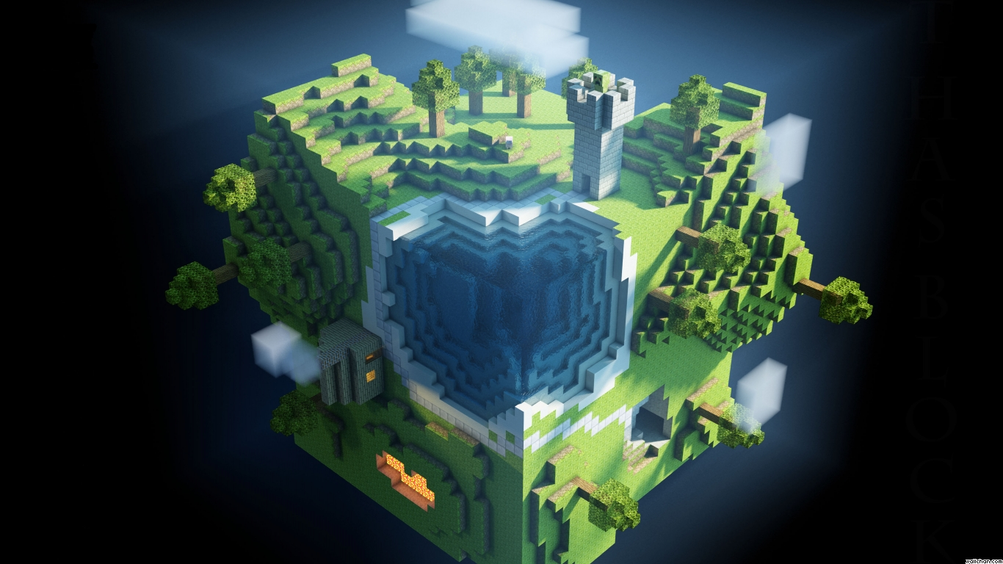
Questions?

Slide 11
Appendix

Slide 12
Player Management – user stories
As a player, I can sign up to the game using:
Username and password
Facebook Account
Google Account
As a player I can login to the game using:
Username and password
Facebook Account
Google Account
As a player I can login with limited capabilities if I’m offline.
As a game developer, I can save user preferences per player using JSON documents.
As a game developer I should be able to register friends of a player.
As a game publisher I can manage and edit user preferences of the registered players using a web based interface.

Slide 13
Leaderboards – user stories
As a game developer I can send achieved scores for a particular game when the player is online.
As a game developer I can cache achieved scores for a particular game when player is offline in order to send later.
As a game developer I can query TOP(n) scores per “this or last”: hour, day, month, year or for all times.
As a game developer I can retrieve the surrounding (n) scores compared to the currently logged in player.
As a game developer I can retrieve high scores of my friends, given a list of friends or a configured connection to a User Management solution.

Slide 14
Analytics – user stories
As a game developer I can send game events to the server for further analysis (GameStarted, SessionStarted, LevelStarted, LevelFinished, CustomEvent, SessionEnded, GameEnded).
As a game publisher I can monitor live events and basic KPIs (CCUs, etc.) in an easy to use Web Interface.
As a game publisher I can get batched reports on basic KPIs (retention, active users per day/week/month, average session length, etc.).
As a game developer I can easily add additional historical, near real time and predictive analytical queries.

Slide 15
What it’s not
It’s not a multitenant service
It’s not a service run by Microsoft

Slide 16
Thank you!

